Slide 1
4-12-2025 Enclosure Design Updates

Slide 2
List of Items to Update
Round all the edges
Add tolerance to the back door (shrink by 1 mm in x and 1 mm in y)
Reduce tolerance on screen fitting by 1 mm in x and 1 mm in y
Make screen mount inner sketch smaller
Align things properly in the assembly
Speaker mount hole spacing needs to be wider
Add a microphone mount

Slide 3
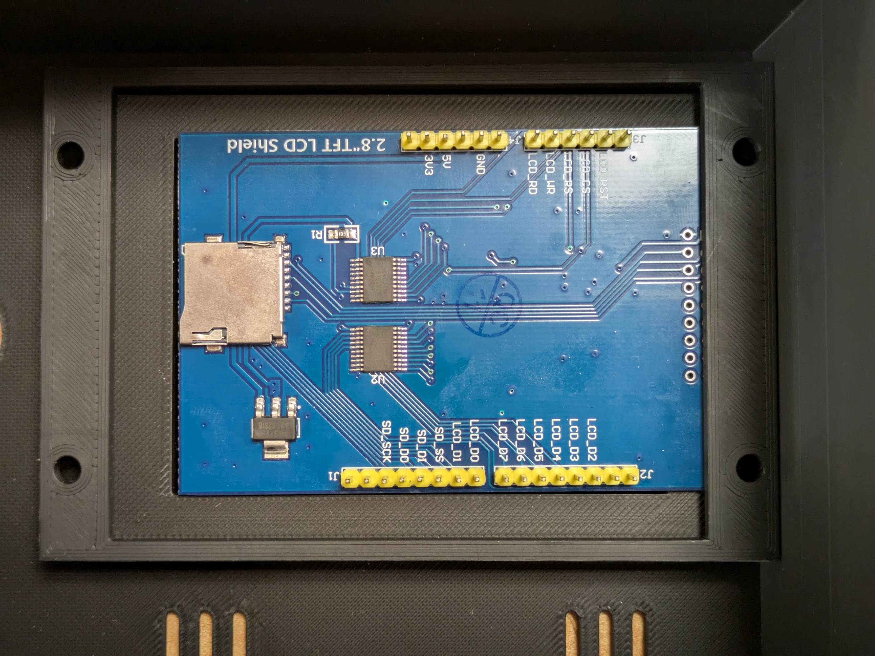
Screen Mount Resizing
15 by 15 mm
Increase left side overhang by up to 15 mm
Increase down by 15 mm from top
Increase up by 20 mm from bottom
Increase right side overhang by 5 mm

Slide 4
Speaker mount resizing
39.53 mm maximum distance between screw hole outer edges
currently, with oversized m3 screws (want #4 screws), the maximum distance between screw outer edges is 39.08 mm
loosely measuring, 39.67 mm vs 39.14 mm
so, regardless, want to make holes about 0.5 mm wider
okay, increased center-to-center from 36.5 to 37 mm
speaker holes 34.2 mm min. edge to edge
33.86 screws min edge to edge; still about 0.5 mm
but eyeballing things it looks like you need another 1 mm
just make both

Slide 5
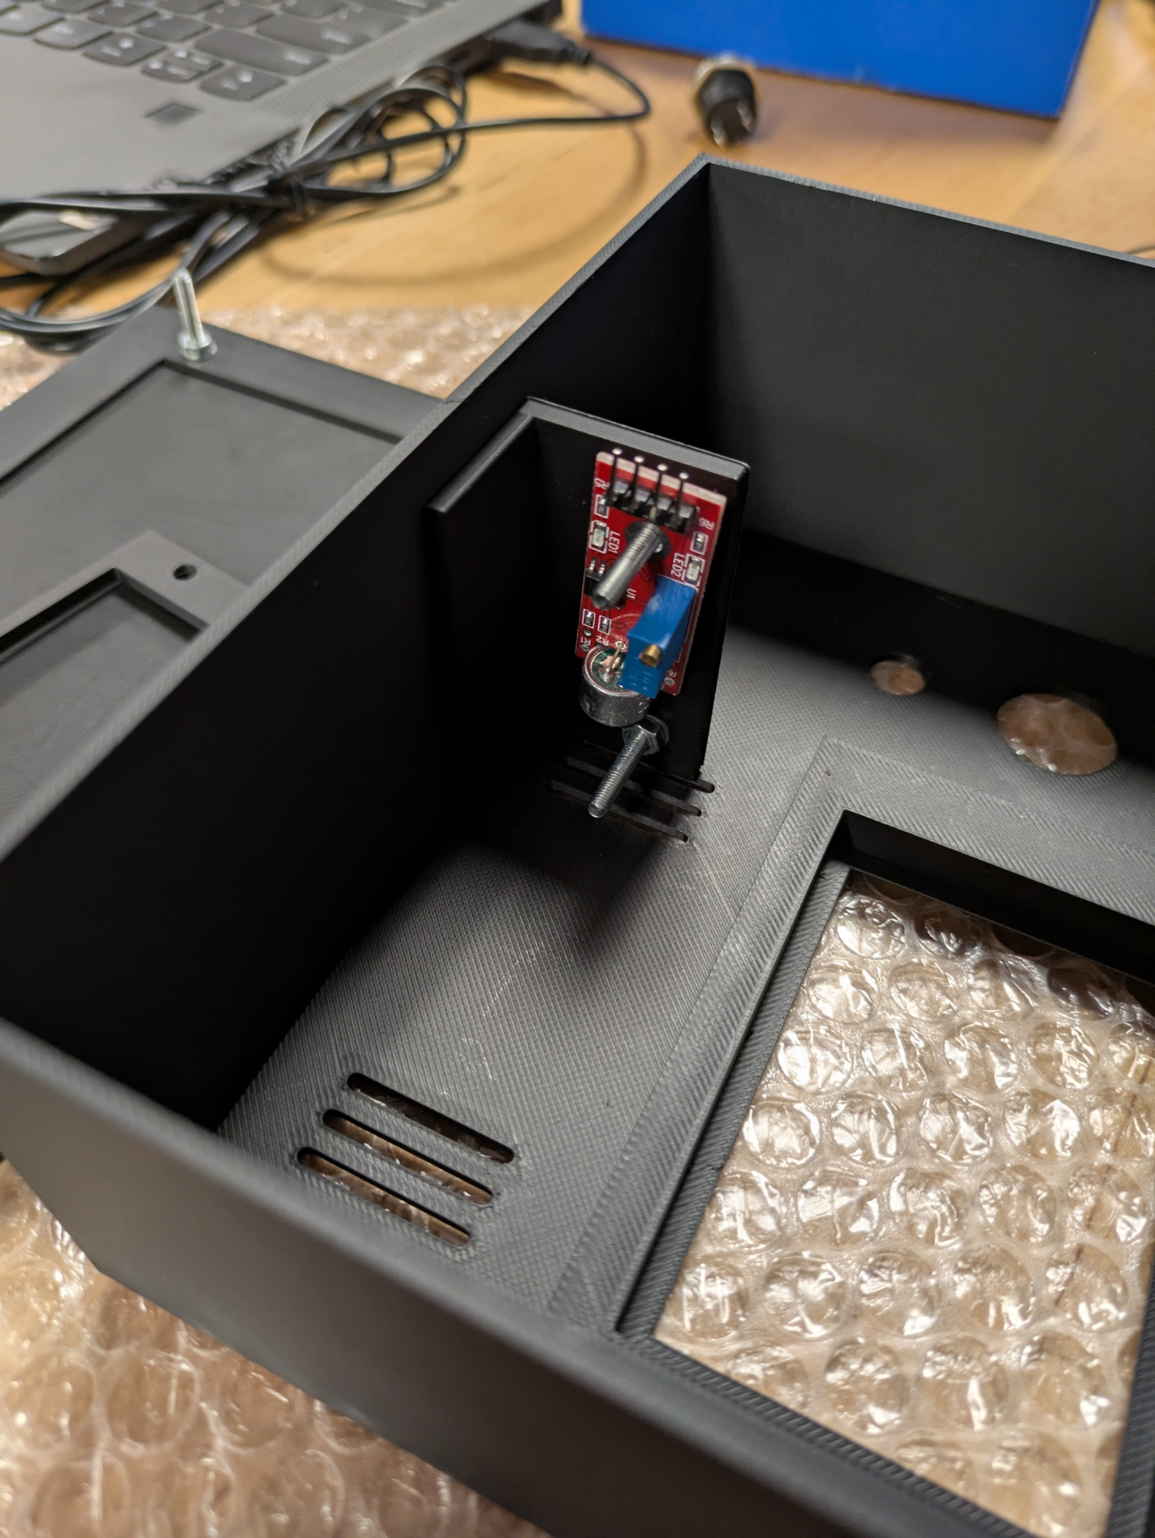
Microphone Mount
lower by 1.25 cm
36.5 mm – 12.5 mm = 24 mm
make a 2nd version with the center to center screw hole distance higher at 26.5 mm

